Slide 1
Megamad
Krazezt

Slide 2
TABLE OF CONTENTS
01
Introduction
What is this game & why I made it?
02
Assets & Materials
Websites that I used assets and materials from.
03
Feature & Gameplay
Yes, feature & gameplay
04
Problems
Some problems I faced while making this game
05
Evaluation
Good/Bad things, etc…

Slide 3
— Me
“Note that this is not the Megaman. This is Megamad =)))”

Slide 4
01
Introduction
What is this game & why I made it?

Slide 5
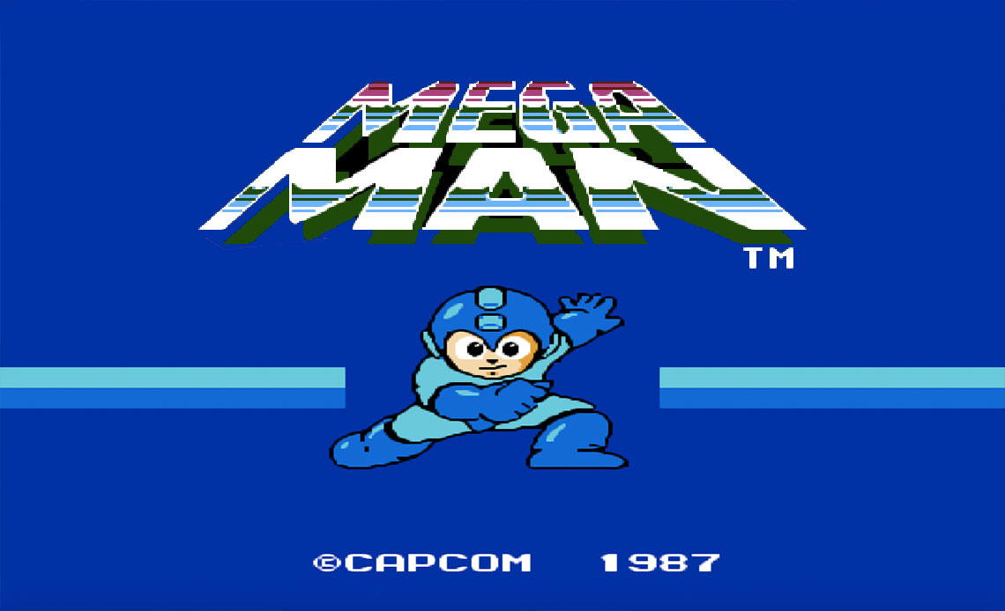
Megaman

Slide 6
Other reason…
Sprite animation, assets, materials,… are so ez to find on the internet :D

Slide 7
02
Assets & Materials

Slide 8



planetminecraft.com
freepik.com
opengameart.org

Slide 9
03
Feature & Gameplay

Slide 10
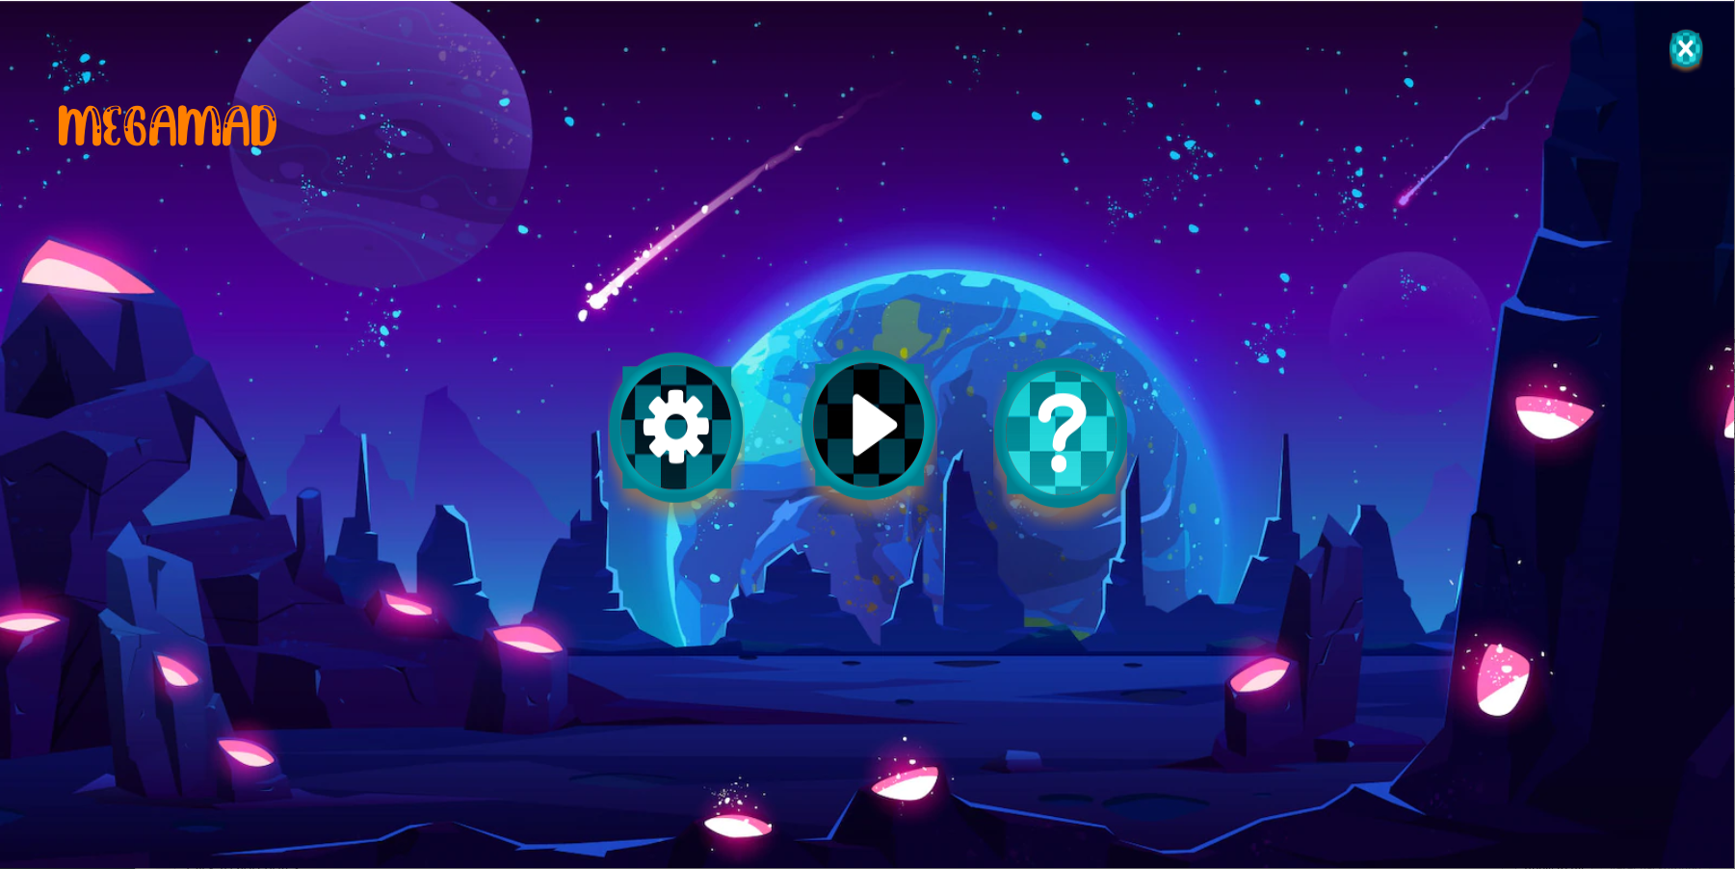
Exit
Play
Settings
Tutorial

Slide 11
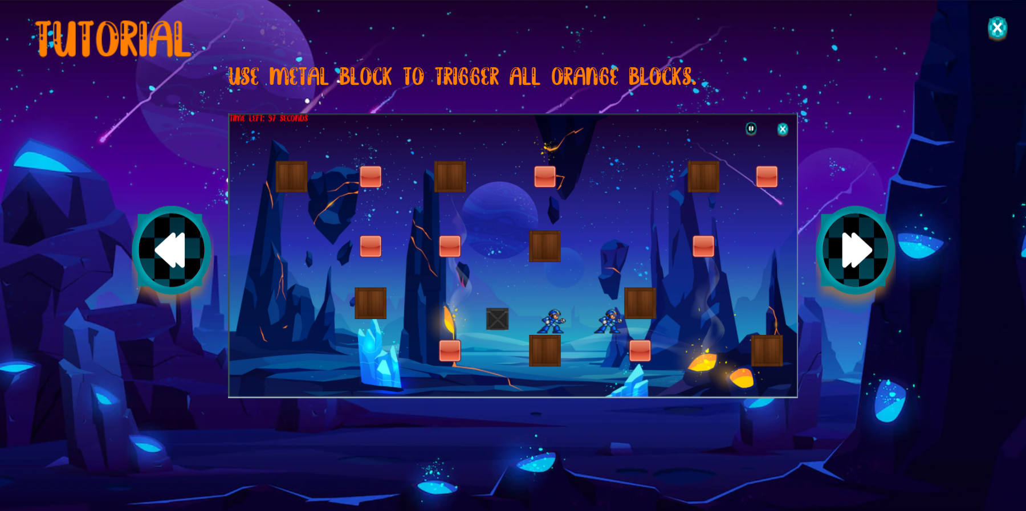
Exit
Next
Prev

Slide 12
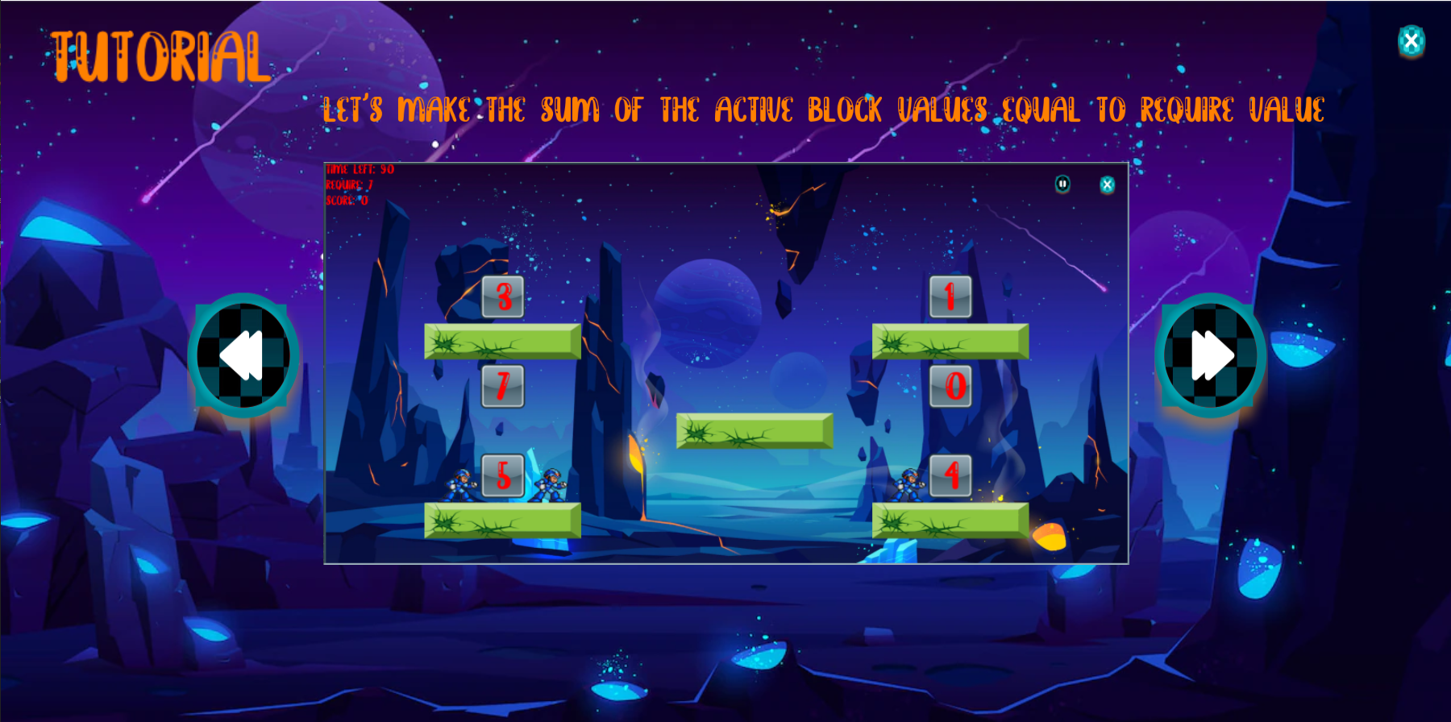
Exit
Next
Prev

Slide 13
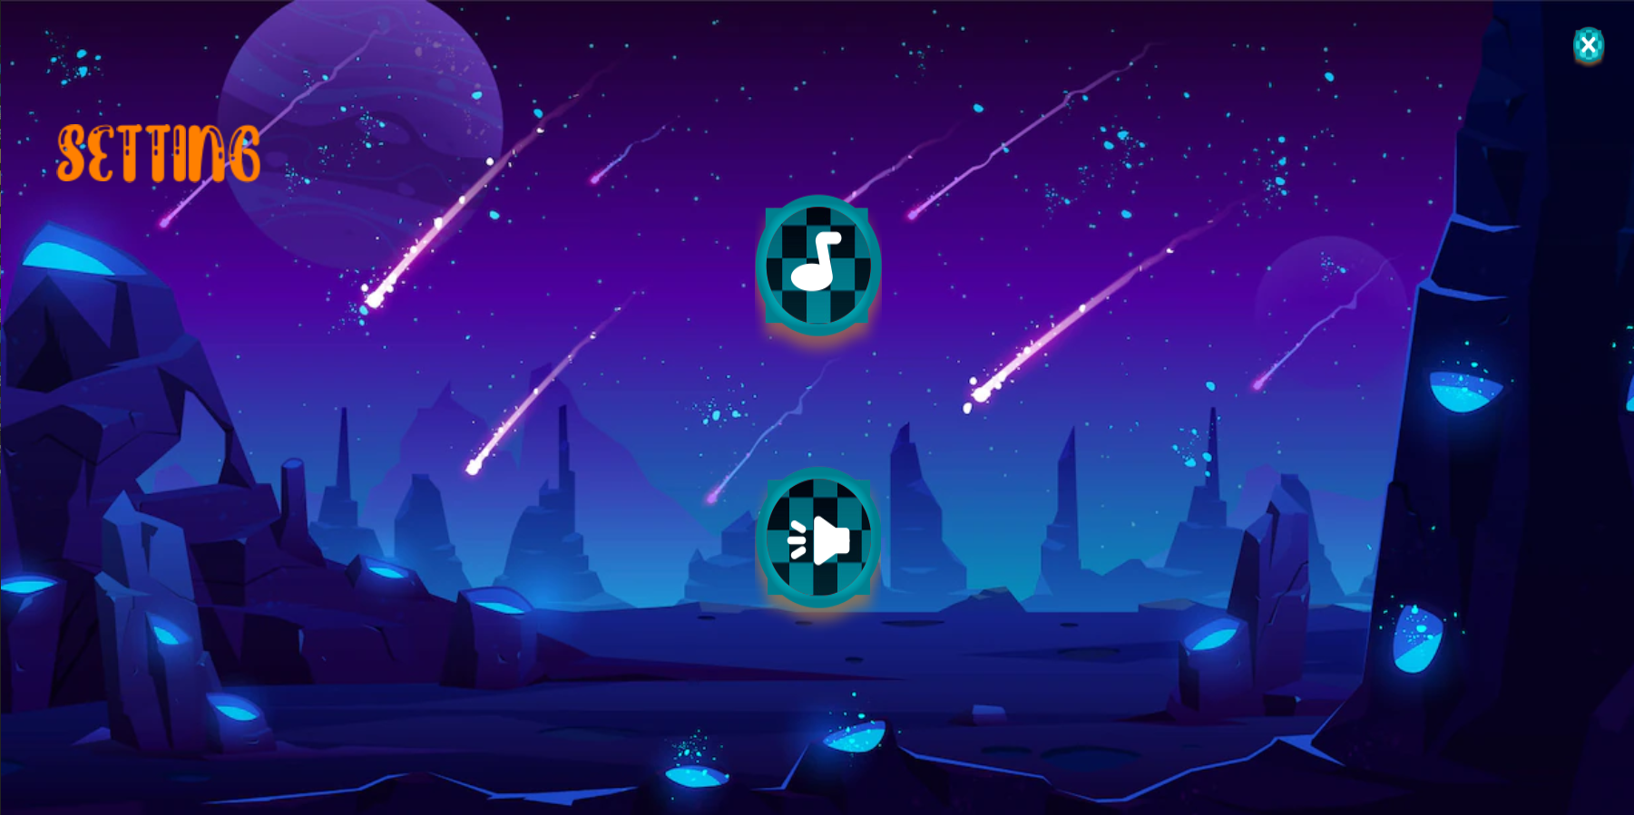
Exit
Music on/off
SFX on/off

Slide 14
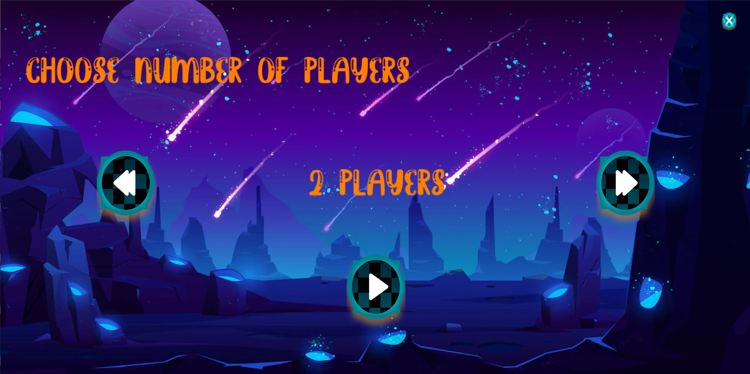
Exit
Less
More

Slide 15
Gameplay
3 game modes

Slide 16
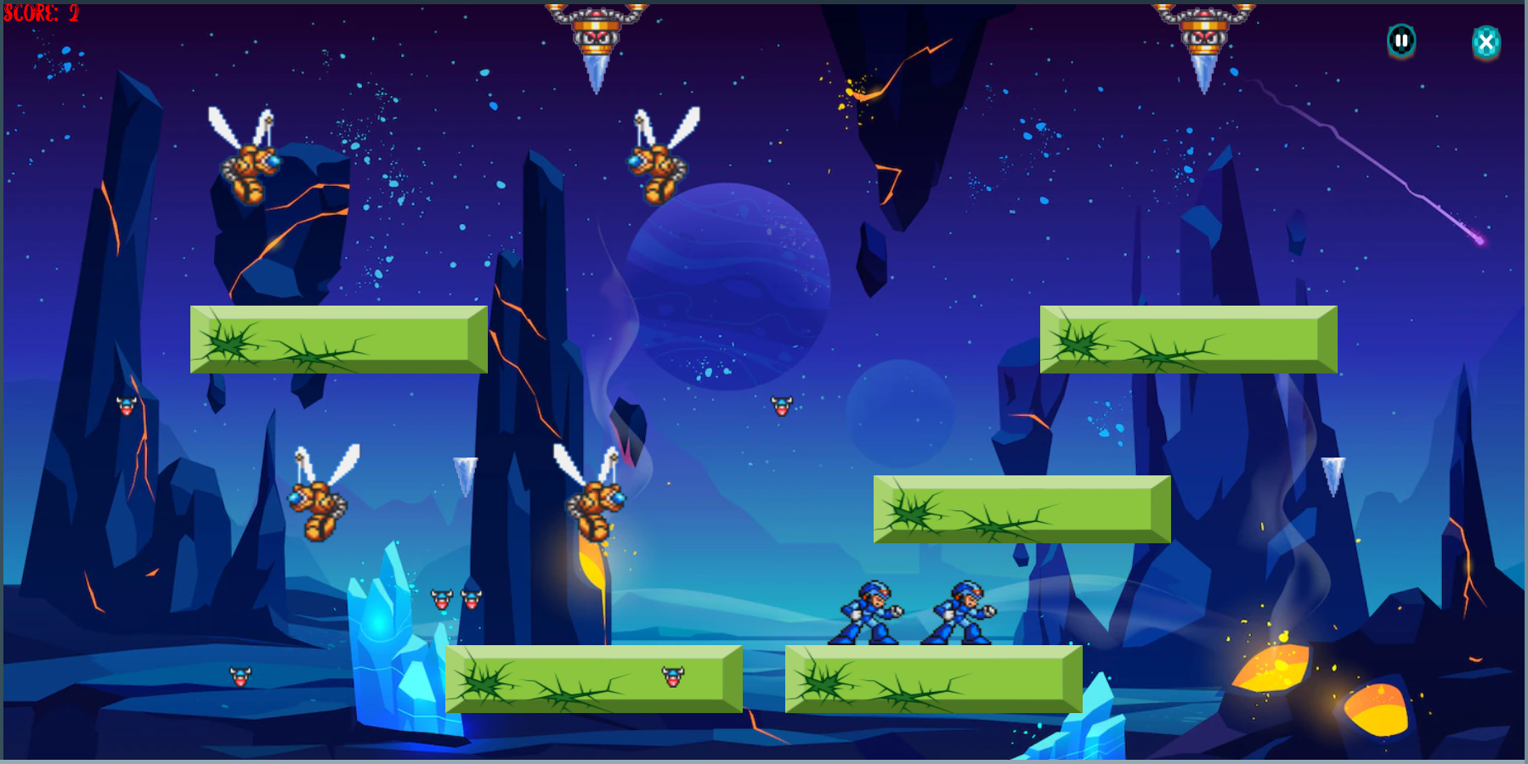

Slide 17
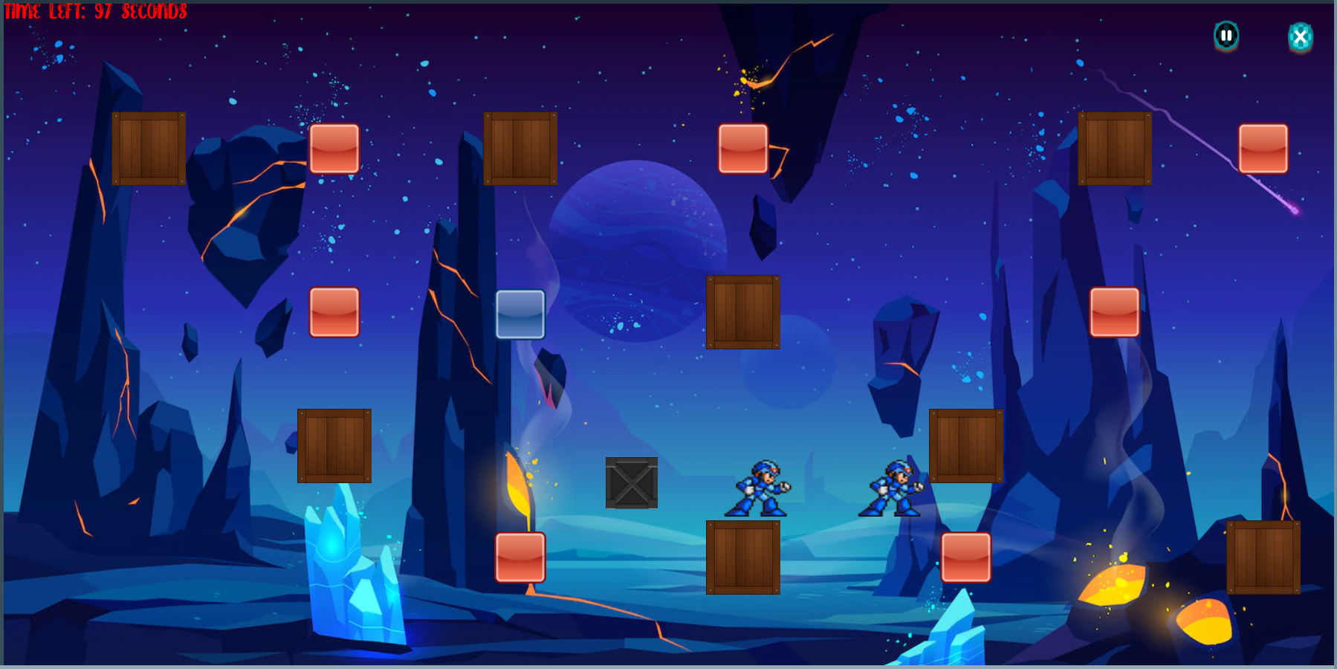

Slide 18
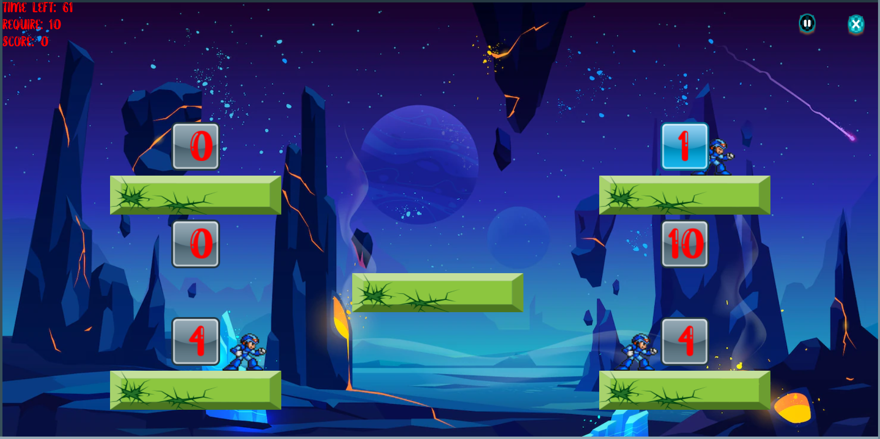

Slide 19
04
Problems

Slide 20
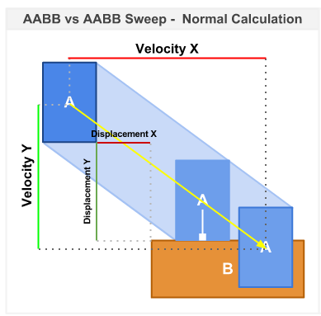
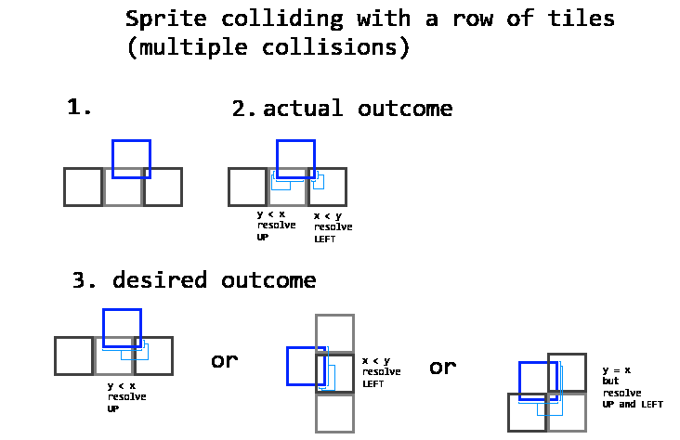
Collision detection & collision resolution

Slide 21
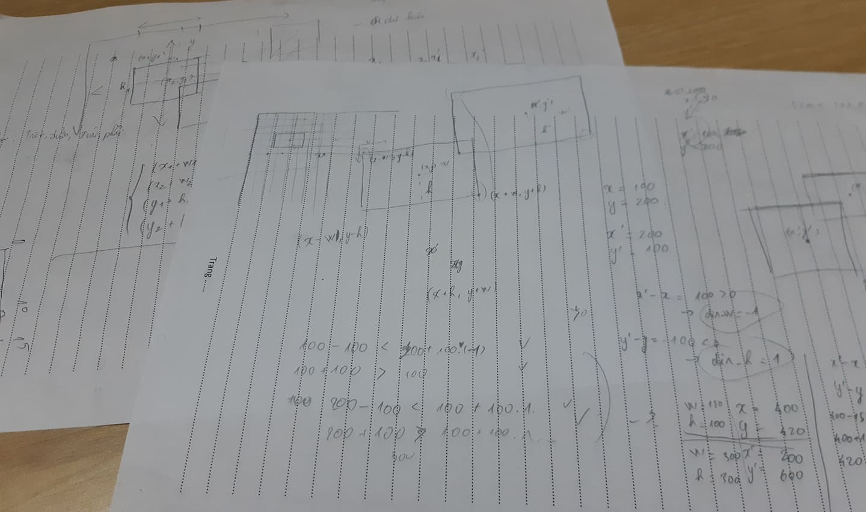
Collision detection & collision resolution

Slide 22
05
Evaluation

Slide 23
Compilable + Playable =))
Have basic settings
Multiplayers
3 game modes
Tutorials

Slide 24
Sometimes collision detection and resolution is wrong
There are only few levels

Slide 25
THANKS
Do you have any questions?
github.com/krazezt

